Slide 1
Volunteer Management System
Presented by Team SE18-08S

Slide 2
Agenda
Project Revisit
Use Case Modeling
Software Architecture
Demo of Prototype
Transition Strategy
Project Progress
Challenges & Problems
Q & A

Slide 3
Project REVISIT
Volunteer Management System

Slide 4
Project revisit
Purpose: To build a web-based solution to facilitate the process of volunteer registration, project management till retention.
Requirement overview:
Volunteer Management
Staff Management
Project Management
Itinerary Management
Administration

Slide 5
Agenda
Project Revisit
Use Case Modeling
Software Architecture
Demo of Prototype
Transition Strategy
Project Progress
Development Plan
Challenges & Problems
Q & A

Slide 6
Use Case Modeling
Volunteer Management System

Slide 7
Use Case Modeling
27 use cases
2 parent actors
Staff
User
5 specific Actors
Staff:
Project Manager
Coordinator
System Administrator
User
Volunteer
Anonymous user

Slide 8
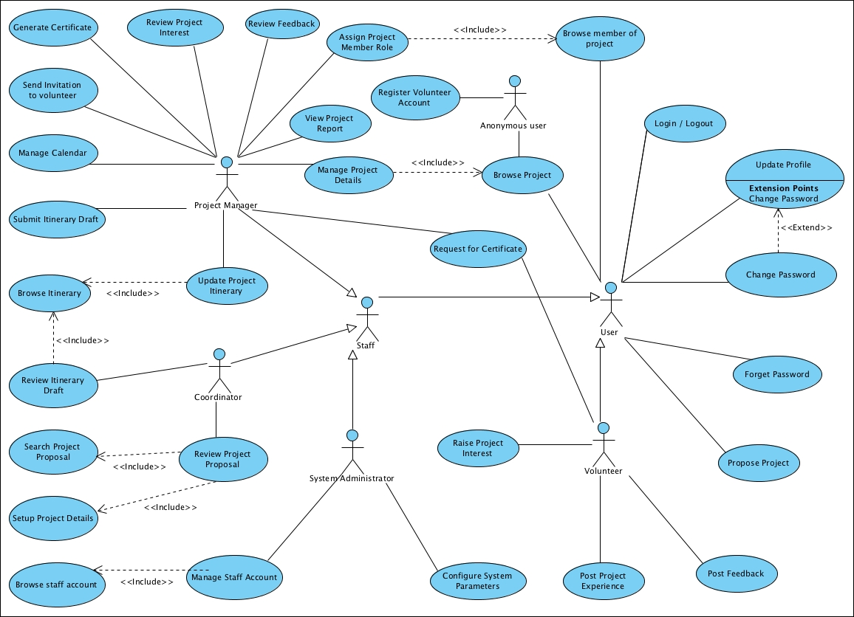

Slide 9
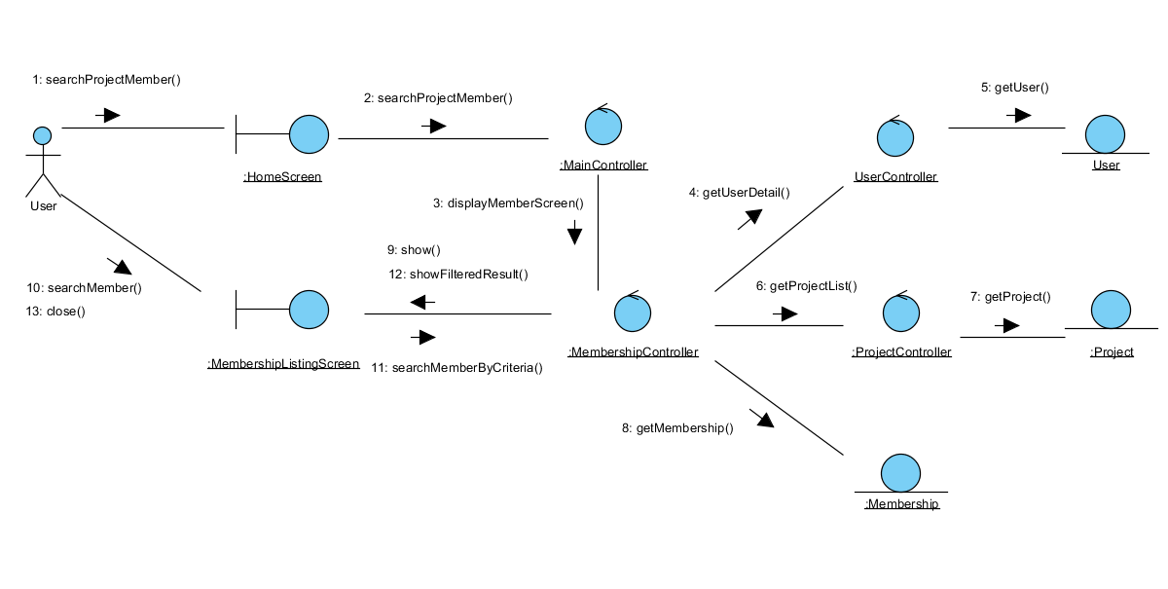
Use Case Modeling – Use Case 1: Search Project Member
Description: This use case allows VMS user to search and view the member list of a project.

Slide 10
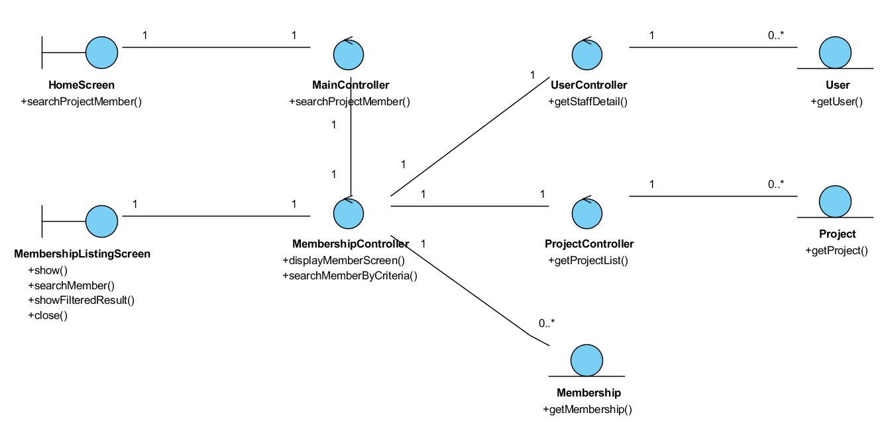
Use Case Modeling – Use Case 1: Search Project Member
Class diagram

Slide 11
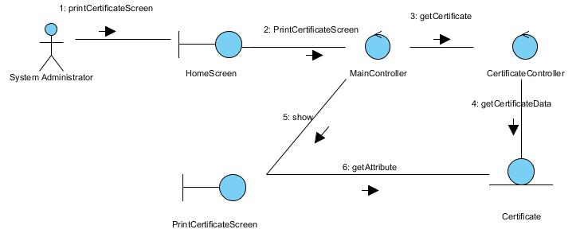
Use Case Modeling – Use Case 2: Print Certificate
Description: The use case enables the System Administrator to print certificate of a volunteer for the projects that he/she has participated in.

Slide 12
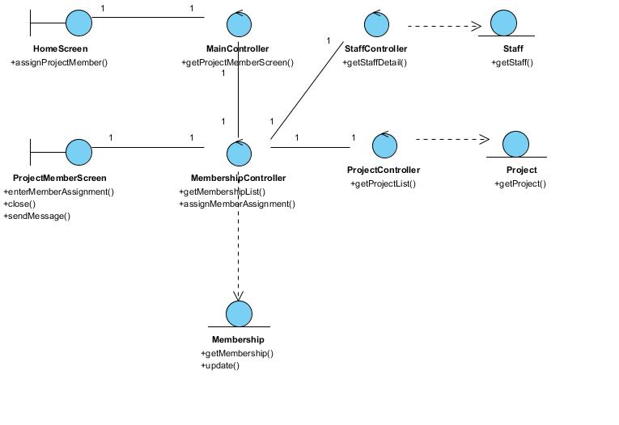
Use Case Modeling – Use Case 2: Print Certificate
Class diagram

Slide 13
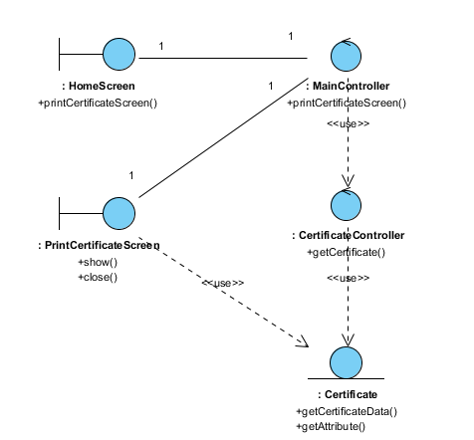
Use Case Modeling – Use Case 2: Assign Role to Project Member
Class diagram

Slide 14
Agenda
Project Revisit
Use Case Modeling
Software Architecture
Demo of Prototype
Transition Strategy
Project Progress
Development Plan
Challenges & Problems
Q & A

Slide 15
Software Architecture
Volunteer Management System

Slide 16
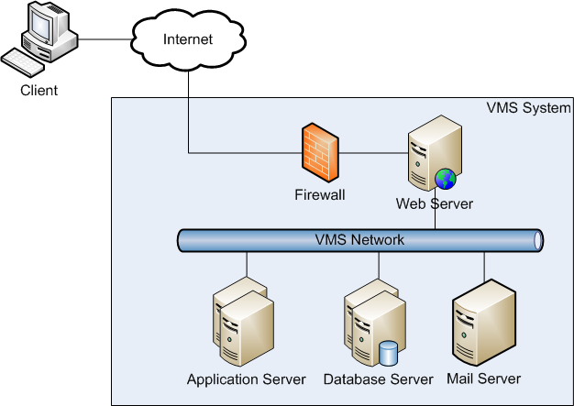
High Level Architecture –Architecture Overview

Slide 17
High Level Architecture –Architecture Overview
Web Server
Apache 2.2
Apache Load Balancer (JK module)
Application Server
Tomcat 6.0
Database Server (RDBMS)
Microsoft SQL Server 2008
Mail Server
POP Mail server (eg. Gmail)

Slide 18
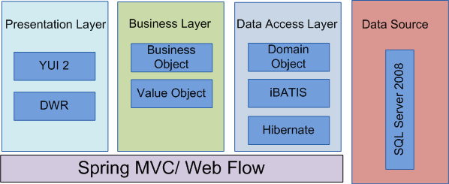
High Level Architecture – Framework Overview

Slide 19
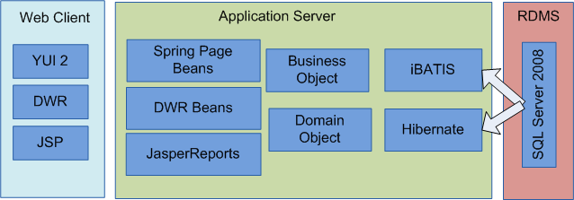
High Level Architecture – Overview of Components

Slide 20
Agenda
Project Revisit
Use Case Modeling
Software Architecture
Demo of Prototype
Transition Strategy
Project Progress
Development Plan
Challenges & Problems
Q & A

Slide 21
Demo of Prototype
Volunteer Management System

Slide 22
Demonstration of Prototype
Purpose of Technical Prototype:
Confirm system components working
Confirm feasibility and reusability
User Interface Prototype
Review usability
Confirm UI design with user

Slide 23
Agenda
Project Revisit
Use Case Modeling
Software Architecture
Demo of Prototype
Transition Strategy
Project Progress
Development Plan
Challenges & Problems
Q & A

Slide 24
Transition Strategy
Volunteer Management System

Slide 25
Transition Strategy – Analysis to Design
Project Planning
Analysis and Design
Prototyping
Use Case Modeling
Use Case Realisation Report
High-level System Design
Software Architecture
Transition Strategy from Analysis to Design
Project Management

Slide 26
Transition Strategy – Analysis to Design
No | Task | Description | In-Charge
1. | Prototyping | User interface prototyping Technical prototyping | Feng Yan, Jifa Zaw
2. | Use Case Modeling | Use case model survey | Thida, Hazel
3. | Use case realisation report | Use case realisation report | Thida, Hazel
4. | Software Design | High level software architecture design document | Zaw
5. | Transition Strategy from Analysis to Design | Transition Strategy from Analysis to Design | Zaw
6. | Project Management | Transition Strategy from Analysis to Design | Dio

Slide 27
Transition Strategy
Active member involvement
Involve all team members by clear and thorough communication
Clearly define roles and responsibilities
Assign tasks to staff by capability and experience
Active risk management
Anticipate risk early, accept and mitigate following the risk management techniques
Enforce tracking practices
Monthly progress update

Slide 28
Agenda
Project Revisit
Use Case Modeling
Software Architecture
Demo of Prototype
Transition Strategy
Project Progress
Development Plan
Challenges & Problems
Q & A

Slide 29
PROJECT Progress
Volunteer Management System

Slide 30
Project Progress
No | Activity | Planned Start Date | Planned End Date | Actual Start Date | Actual End Date | Planned Effort | Actual Effort | Task Status | Comments
1 | Project Planning
1.1 | Produce Project Plan | 21 Jan 2011 | 02 Apr 2011 | 20 Feb 2011 | 09 Apr 2011 | 7 | 9 | Done | Requirements gathering issues.
1.2 | Produce Quality Plan | 21 Jan 2011 | 02 Apr 2011 | 20 Feb 2011 | 05 Apr 2011 | 6 | 6.025 | Done | Makes changes based on Audit Meeting feedback
1.3 | Prepare First Audit & Presentation | 21 Jan 2011 | 02 Apr 2011 | 03 Apr 2011 | 09 Apr 2011 | 9 | 9 | Done
2 | Requirement Analysis
2.1 | Produce User Requirements Specifications | 22 Jan 2011 | 02 Apr 2011 | 20 Jan 2011 | 02 Apr 2011 | 18 | 13.6875 | Done
3 | Analysis Modelling
3.1 | Produce Functional Specifications : UCMS and UCRR (Analysis) | 10 Apr 2011 | 07 Jul 2011 |  |  | 38 |  | Open
3.3 | Produce Prototyping Study Report | 10 Apr 2011 | 12 Jun 2011 |  |  | 17.5 |  | Open

Slide 31
Agenda
Project Revisit
Use Case Modeling
Software Architecture
Demo of Prototype
Transition Strategy
Project Progress
Development Plan
Challenges & Problems
Q & A

Slide 32
DEVELOPMENT PLAN
Volunteer Management System

Slide 33
Development plan
No | Activity | Planned Start Date | Planned End Date | Actual Start Date | Actual End Date | Planned Effort | Actual Effort | Task Status | Comments
1 | Project Planning
1.1 | Produce Project Plan | 21 Jan 2011 | 02 Apr 2011 | 20 Feb 2011 | 09 Apr 2011 | 7 | 9 | Done | Requirements gathering issues.
1.2 | Produce Quality Plan | 21 Jan 2011 | 02 Apr 2011 | 20 Feb 2011 | 05 Apr 2011 | 6 | 6.025 | Done | Makes changes based on Audit Meeting feedback
1.3 | Prepare First Audit & Presentation | 21 Jan 2011 | 02 Apr 2011 | 03 Apr 2011 | 09 Apr 2011 | 9 | 9 | Done
2 | Requirement Analysis
2.1 | Produce User Requirements Specifications | 22 Jan 2011 | 02 Apr 2011 | 20 Jan 2011 | 02 Apr 2011 | 18 | 13.6875 | Done
3 | Analysis Modelling
3.1 | Produce Functional Specifications : UCMS and UCRR (Analysis) | 10 Apr 2011 | 07 Jul 2011 |  |  | 38 |  | Open
3.3 | Produce Prototyping Study Report | 10 Apr 2011 | 12 Jun 2011 |  |  | 17.5 |  | Open

Slide 34
Agenda
Project Revisit
Use Case Modeling
Software Architecture
Demo of Prototype
Transition Strategy
Project Progress
Development Plan
Challenges & Problems
Q & A

Slide 35
Challenges & Problems
Volunteer Management System

Slide 36
Challenges & Problems
No | Challenge | Description | Solution
1. | Communications | Difficulty to gather all members for discussions. | Online meeting via Skype To fix a weekly meeting time
2. | Requirements Gathering | Client only wants a small set of requirements. | Seek lecturers advice Proposed merging of requirements Appoint team members as putative end users Look for alternative customer
3. | Task Control | Not able to meet deadline on time. | To log time log To hold meetings to track status
4. | Low Quality of Work | Deliverables not up to standard. | Perform reviews Conduct briefing and demo on required items

Slide 37
Agenda
Project Revisit
Use Case Modeling
Software Architecture
Demo of Prototype
Transition Strategy
Project Progress
Challenges & Problems
Q & A

Slide 38
Question & Answer

